Slide 1
Introducing Bitcoin
Created by Satoshi Nakamoto in 2008. It was published as a white paper ‘Bitcoin: A Peer-to-Peer Electronic Cash System. This paper is available at https://bitcoin.org/en/bitcoin-paper’
It is the most successful digital currency with billions of dollars invested.
It has gained high number of users and investors, frequent new coverage, and growing number of Bitcoin-based startups and exchanges.
Bitcoin futures are traded on the Chicago Mercantile Exchange (CME).
Bitcoin can be defined in various ways; it’s a protocol, a digital currency, and a platform.
It is a combination of a P2P network, protocols, and software that facilitates the creation and usage of the digital currency.
Nodes in this P2P network talk to each other using the Bitcoin protocol.

Slide 2
Introducing Bitcoin
Various ideas and techniques from cryptography and distributed computing such as Merkle trees, hash functions, and digital signatures were used to design Bitcoin.
BitGold, b-money, hashcash, and cryptographic time-stamping also provided some groundwork for the invention of Bitcoin.
It is the first ever truly decentralized currency.
Bitcoin solves several historically difficult problems related to electronic cash and distributed systems, including:
  The Byzantine generals problem
  Sybil attacks
  The double-spending problem

Slide 3
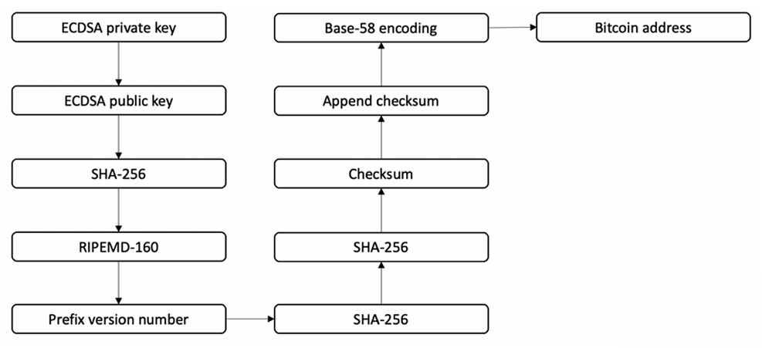
Addresses generation procedure in Bitcoin

